Slide 1


Tulluru Sucharitha
15 JUN 2024

Slide 2
Outline
Executive Summary
Introduction
Methodology
Results
Conclusion
Appendix
2

Slide 3
Introduction
Project background and context
With the recent successes in private space travel, space industry is becoming more and more mainstream and accessible to general population. Cost of launch continues to remain a key barrier for new competitors to enter the space race
SpaceX with its first stage reuse capabilities offers a key advantage against its competitors. Each SpaceX launch costs around 62 million dollar and SpaceX can reuse stage 1 for future launches. This provides SpaceX a unique advantage where other competitors are spending around 165 mission plus for each launch
Problems you want to find answers
Determine if the first stage of SpaceX Falcon 9 will land successfully
Impact of different parameters/variables on the landing outcomes (e.g., launch site, payload mass, booster version, etc.)
Correlations between launch sites and success rates
3

Slide 4

5

Slide 5
Methodology
Executive Summary
Data collection methodology:
SpaceX API
Web scrap Falcon 9 and Falcon Heavy launch records from Wikipedia (link)
Perform data wrangling
Determined labels for training the supervised models by converting mission outcomes in to training labels (0-unsuccessful, 1-successful)
Perform exploratory data analysis (EDA) using visualization and SQL
Perform interactive visual analytics using Folium and Plotly Dash
Perform predictive analysis using classification models
Created a column for ‘class’; standardized and transformed data; train/test split data; find best classification algorithm (Logistic regression, SVM, decision tree, & KNN) using test data
6

Slide 6
Data Collection
Data collection is the process of gathering data from available sources. This data can be structured, unstructured, or semi-structured. For this project, data was collected via SpaceX API and Web scrapping Wiki pages for relevant launch data.
SpaceX API Web scraping data from Wiki
Read API response
Read .json response and convert to a Dataframe
Convert to CSV format
Convert new Dataframe to CSV format for the next phase
Create Beautiful Soap
Create beautiful soap object from HTML response
Convert to CSV format
Convert Dataframe to CSV for next phase
Request launch data from SpaceX API
Extract relevant data fields to match the requirements
Prelim data wrangling
Request Falcon9 html page via HTTP GET method
Collect all relevant headers/extract rows to Datafame
API request
Perform HTTP GET
Extract data to DF
7

Slide 7
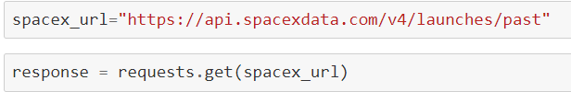
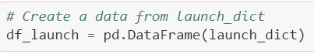
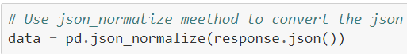
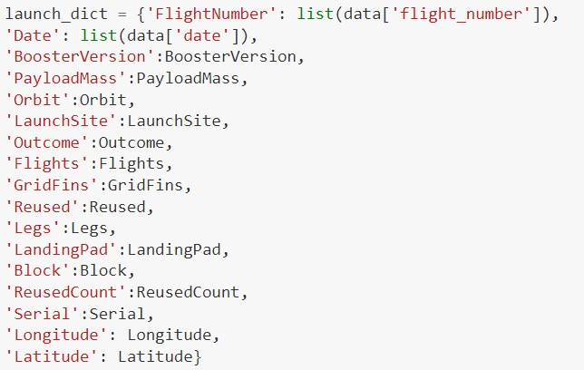
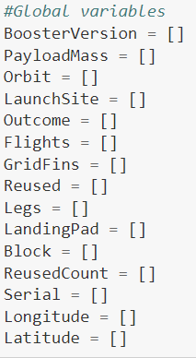
Data Collection – SpaceX API
1. API Request and read response into DF
2. Declare global variables
3. Call helper functions with API calls to populate global vars
4. Construct data using dictionary
5. Convert Dict to Dataframe, filter for Falcon9 launches, covert to CSV
1. Create API GET request, normalize data and read in to a Dataframe:
Call helper functions to get relevant data where columns have IDs (e.g., rocket column is an identification number)
getBoosterVersion(data)
getLaunchSite(data)
getPayloadData(data)
getCoreData(data)
4. Create Dataframe from dictionary and filter to keep only the Falcon9 launches:
• c
4. Construct dataset from received data & combine columns into a dictionary:
2. Declare global variable lists that will store data returned by helper functions with additional API calls to get relevant data
7

Slide 8
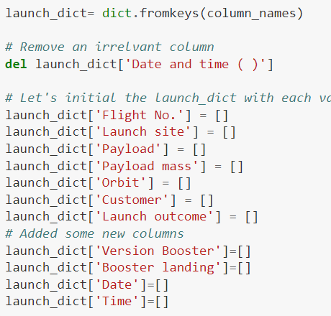
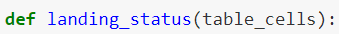
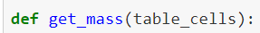
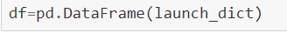
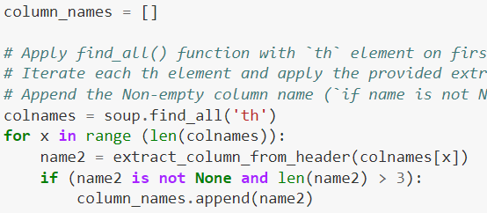
Data Collection - Scraping
1. Perform HTTP GET to request HTML page
2. Create Beautiful Soap object
3. Extract column names from HTML table header
4. Create Dictionary with keys from extracted column
names
5. Call helper functions to fill up dict with launch records
6. Convert Dictionary to Dataframe
1. Create API GET method to request Falcon9 launch HTML page
4. Create an empty Dictionary with keys from extracted column names:
Fill up the launch_dict with launch records extracted from table rows.
Utilize following helper functions to help parse HTML data
• c
2. Create Beautiful Soap object
3. Find all the tables on the Wiki page and extract relevant column names from the HTML table header
6. Convert launch_dict to Dataframe:
8

Slide 9
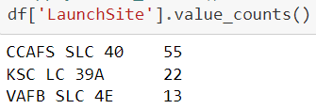
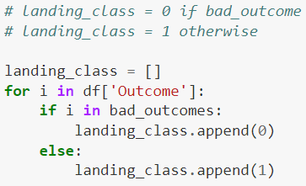
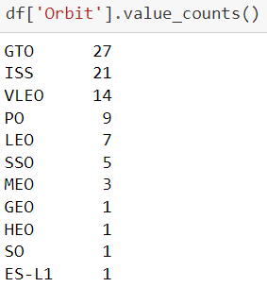
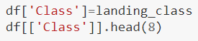
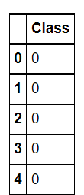
Data Wrangling – cont’d
1. Load dataset in to Dataframe
2. Find patterns in data
3. Create landing outcome label
1. Load SpaceX dataset (csv) in to a Dataframe
Find data patterns:
Calculate the number of launches on each site
Calculate the number and occurrence of each orbit
Calculate number/occurrence of mission outcomes per orbit type
3. Create a landing outcome label from Outcome column in the Dataframe
11

Slide 10
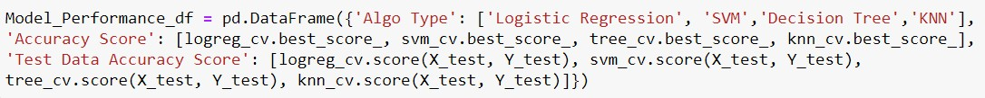
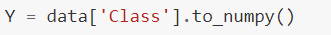
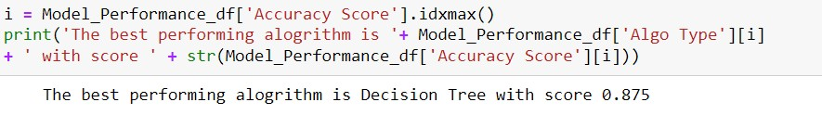
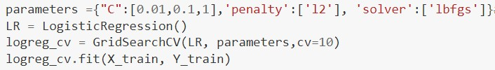
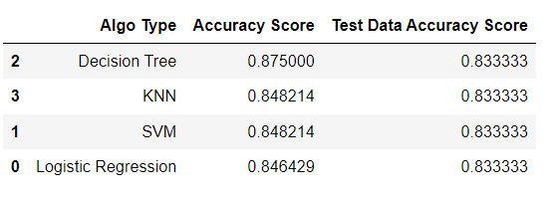
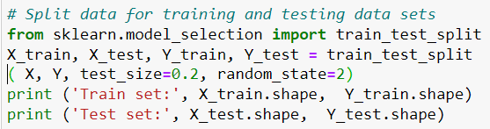
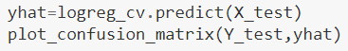
Predictive Analysis (Classification)
1. Read dataset into Dataframe
and create a ‘Class’ array
2. Standardize the data
3. Train/Test/Split data in to
training and test data sets
4. Create and Refine Models
5. Find the best performing
Model
1. Load SpaceX dataset (csv) in to a Dataframe and create NumPy array from the column class in data
Create and refine Models based on following classification Algorithms: (below is LR example)
Create Logistic Regression object and then
create a GridSearchCV object
Fit train data set in to the GridSearchCV object and train the Model
Find and display best hyperparameters and accuracy score
Check the accuracy on the test data by creating a confusion matrix
Repeat above steps for Decision Tree, KNN, and SVM algorithms
3. Find the best performing model
2. Standardize data in X then reassign to variable X using transform
3. Train/test/split X and Y in to training and test data sets.

Slide 11
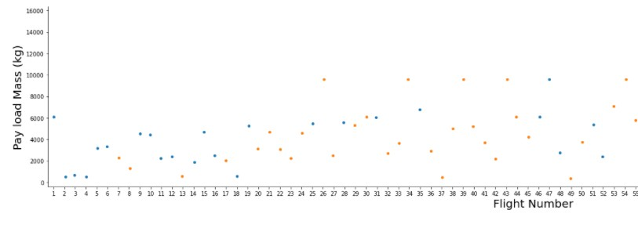
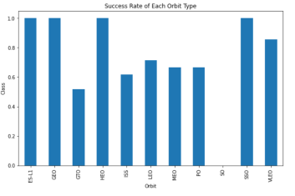
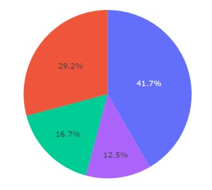
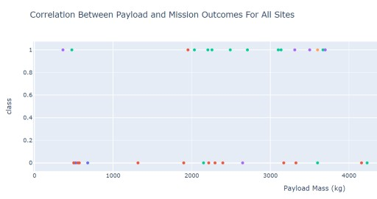
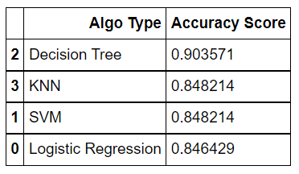
Results
Following sections and slides explain results for:
Samples:
Exploratory data
analysis results
Samples
Interactive analytics demo in screenshots
Samples
Predictive analysis
results
17

Slide 12


Slide 13
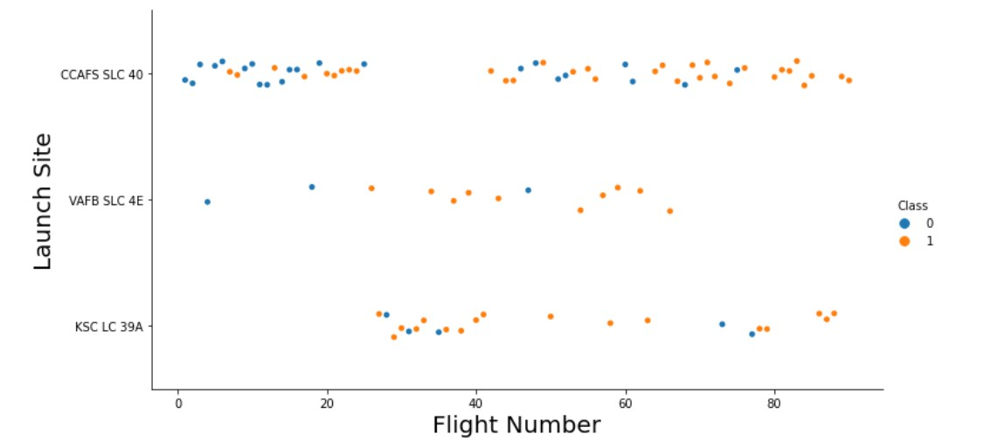
Flight Number vs. Launch Site
Success rates (Class=1) increases as the number of flights increase
For launch site ‘KSC LC 39A’, it takes at least around 25 launches before a first
successful launch

Slide 14
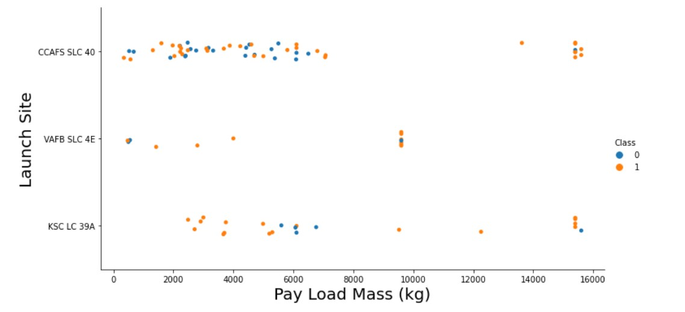
Payload vs. Launch Site
For launch site ‘VAFB SLC 4E’, there are no rockets launched for payload
greater than 10,000 kg
Percentage of successful launch (Class=1) increases for launch site ‘VAFB SLC 4E’ as the payload mass increases
There is no clear correlation or pattern between launch site and payload
mass

Slide 15
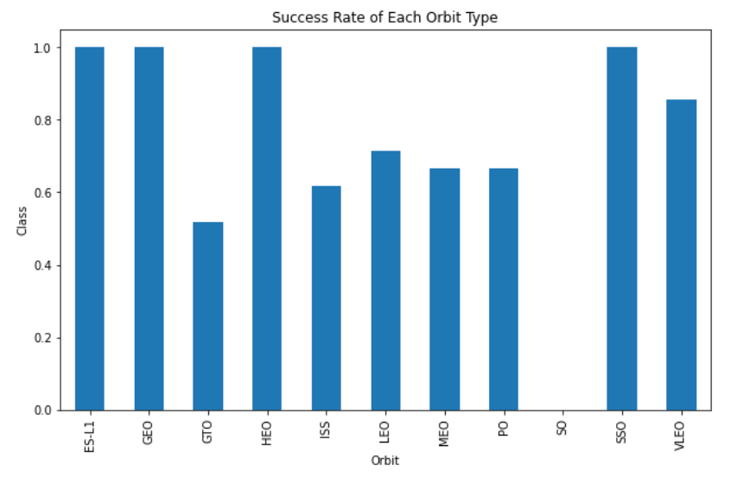
Success Rate vs. Orbit Type
Orbits ES-LI, GEO, HEO, and SSO have the highest success rates
GTO orbit has the lowest success rate

Slide 16
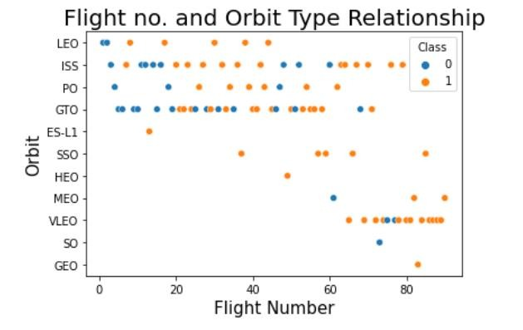
Flight Number vs. Orbit Type
For orbit VLEO, first successful landing (class=1) doesn’t occur until 60+
number of flights
For most orbits (LEO, ISS, PO, SSO, MEO, VLEO) successful landing rates appear to increase with flight numbers
There is no relationship between flight number and orbit for GTO
22

Slide 17
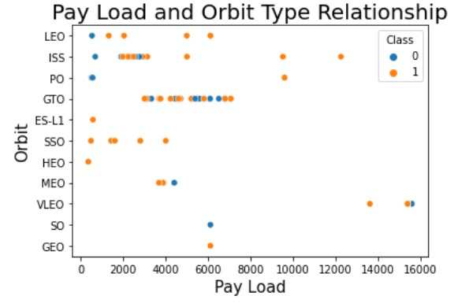
Payload vs. Orbit Type
Successful landing rates (Class=1) appear to increase with pay load for
orbits LEO, ISS, PO, and SSO
For GEO orbit, there is not clear pattern between payload and orbit for successful or unsuccessful landing
23

Slide 18
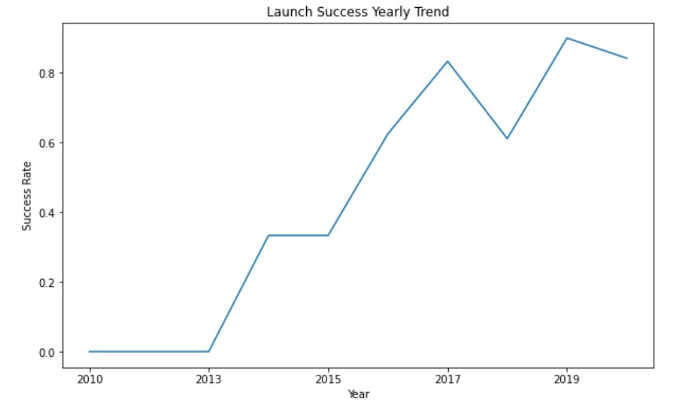
Launch Success Yearly Trend
Success rate (Class=1) increased by about 80% between 2013 and 2020
Success rates remained the same between 2010 and 2013 and between 2014
and 2015
Success rates decreased between 2017 and 2018 and between 2019 and 2020
24

Slide 19
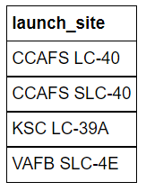
All Launch Site Names
Query:
Description:
‘distinct’ returns only unique values from the queries column (Launch_Site)
There are 4 unique launch sites
Result:

Slide 20
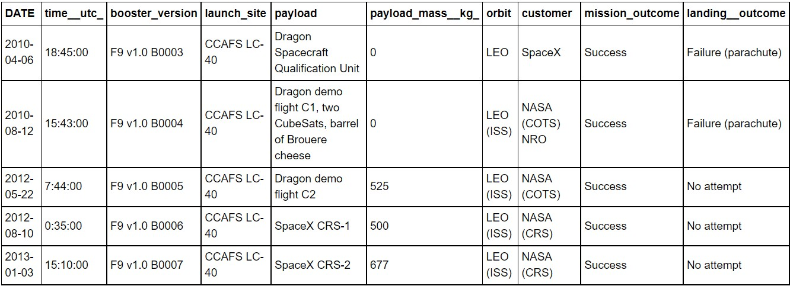
Launch Site Names Begin with 'CCA'
Query:
Description:
Using keyword ‘Like’ and format ‘CCA%’, returns records where ‘Launch_Site’ column
starts with “CCA”.
Limit 5, limits the number of returned records to 5
Result:

Slide 21
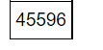
Total Payload Mass
Query:
Description:
‘sum’ adds column ‘PAYLOAD_MASS_KG’ and returns total payload mass for customers named ‘NASA (CRS)’
Result:

Slide 22
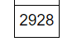
Average Payload Mass by F9 v1.1
Query:
Description:
‘avg’ keyword returns the average of payload mass in ‘PAYLOAD_MASS_KG’ column where booster version is ‘F9 v1.1’
Result:

Slide 23
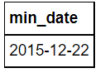
First Successful Ground Landing Date
Query:
Description:
‘min(Date)’ selects the first or the oldest date from the ‘Date’ column where first successful
landing on group pad was achieved
Where clause defines the criteria to return date for scenarios where ‘Landing_Outcome’ value is equal to ‘Success (ground pad)’
Result:

Slide 24
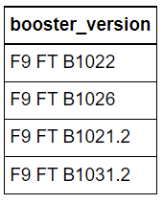
Successful Drone Ship Landing with Payload between 4000 and 6000
Query:
Description:
The query finds the booster version where payload mass is greater than 4000 but less than 6000 and the landing outcome is success in drone ship
The ‘and’ operator in the where clause returns booster versions where both conditions in the where clause are true
Result:

Slide 25
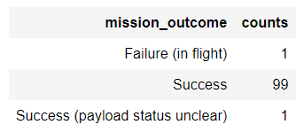
Total Number of Successful and Failure Mission Outcomes
Query:
Description:
The ‘group by’ keyword arranges identical data in a column in to group
In this case, number of mission outcomes by types of outcomes are grouped in column
‘counts’
Result:

Slide 26
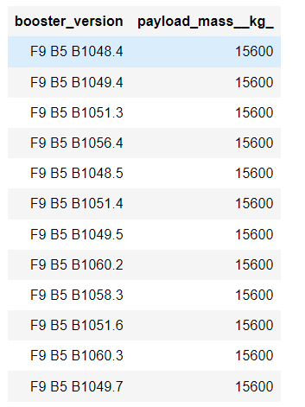
Boosters Carried Maximum Payload
Query:
Description:
The sub query returns the maximum payload mass by using keywork ‘max’ on the pay load
mass column
The main query returns booster versions and respective payload mass where payload mass is maximum with value of 15600
Result:

Slide 27
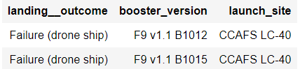
2015 Launch Records
Query:
Description:
The query lists landing outcome, booster version, and the launch site where landing outcome is failed in drone ship and the year is 2015
The ‘and’ operator in the where clause returns booster versions where both conditions in the where clause are true
The ‘year’ keywork extracts the year from column ‘Date
The results identify launch site as ‘CCAFS LC-40’ and booster version as F9 v1.1 B1012 and
B1015 that had failed landing outcomes in drop ship in the year 2015
Result:

Slide 28
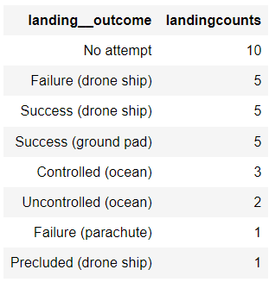
Rank Landing Outcomes Between 2010-06-04 and 2017-03-20
Query:
Description:
The ‘group by’ key word arranges data in column ‘Landing Outcome’ into groups
The ‘between’ and ‘and’ keywords return data that is between 2010-06-04 and 2017-03-20
The ‘order by’ keyword arranges the counts column in descending order
The result of the query is a ranked list of landing outcome counts per the specified date range
Result:

Slide 29


Slide 30
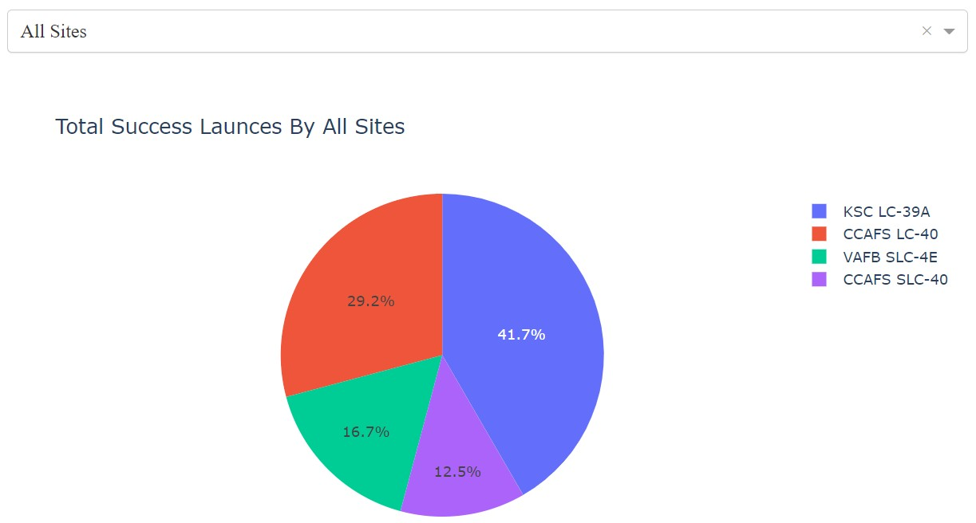
Launch Success Counts For All Sites
Launch Site ‘KSC LC-39A’ has the highest launch success rate
Launch Site ‘CCAFS SLC- 40’ has the lowest launch success rate

Slide 31
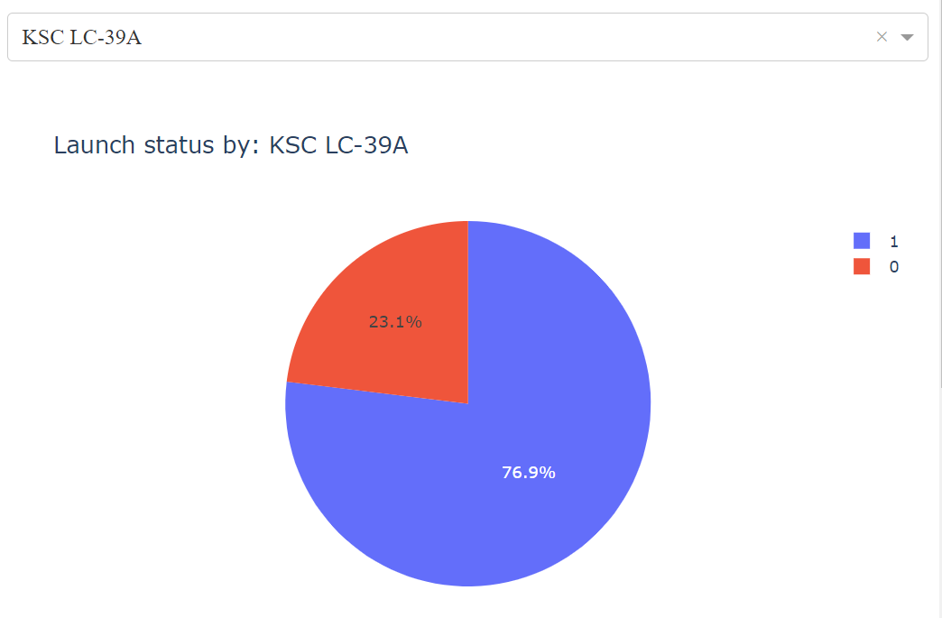
Launch Site with Highest Launch Success Ratio
KSC LC-39A Launch Site has the highest launch success rate and count
Launch success rate is
76.9%
Launch success failure
rate is 23.1%

Slide 32
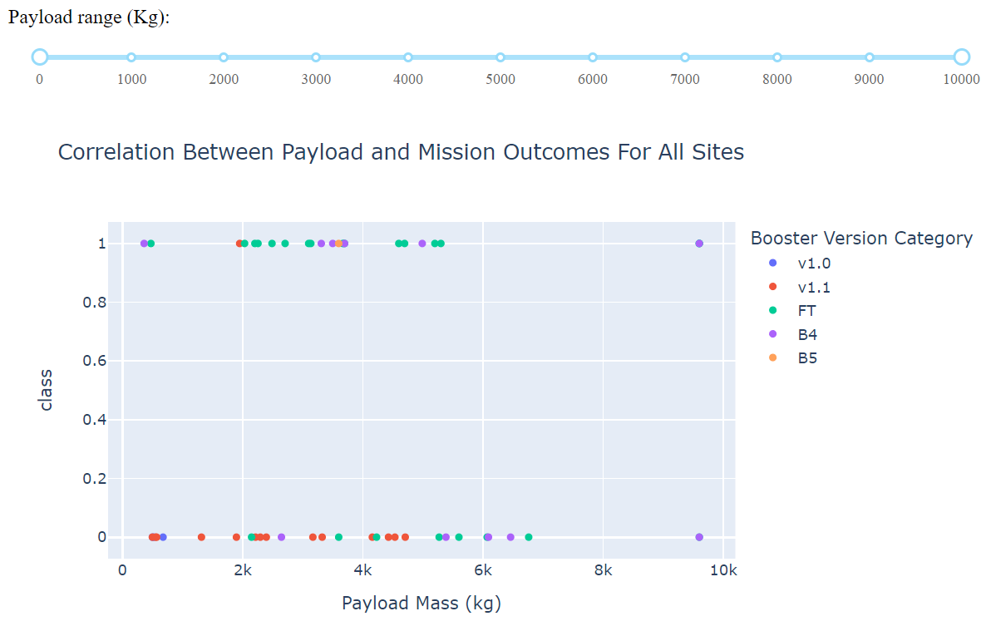
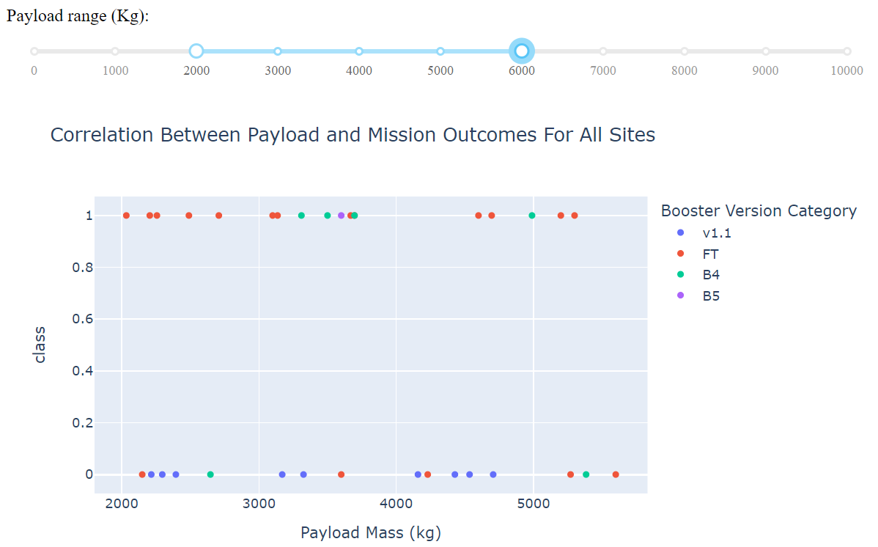
Payload vs. Launch Outcome Scatter Plot for All Sites
Most successful launches are in the payload range from 2000 to about 5500
Booster version category ‘FT’ has the most successful launches
Only booster with a success launch when payload is greater than 6k is ‘B4’
42

Slide 33


Slide 34
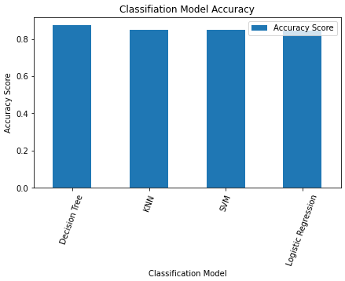
Classification Accuracy
Based on the Accuracy scores and as also evident from the bar chart, Decision Tree algorithm has the highest classification score with a value of .8750
Accuracy Score on the test data is the same for all the classification algorithms based on the data set with a value of .8333
Given that the Accuracy scores for Classfication algorithms are very close and the test scores are the same, we may need a broader data set to further tune the models

Slide 35
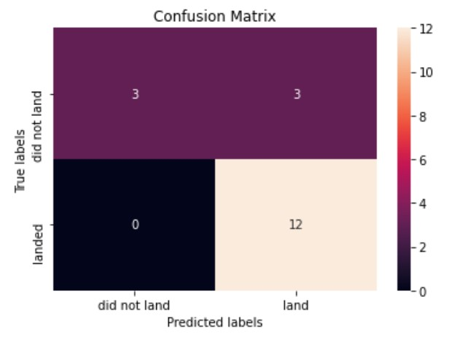
Confusion Matrix
The confusion matrix is same for all the models (LR, SVM, Decision Tree, KNN)
Per the confusion matrix, the classifier made 18 predictions
12 scenarios were predicted Yes for landing,
and they did land successfully (True positive)
3 scenarios (top left) were predicted No for landing, and they did not land (True negative)
3 scenarios (top right) were predicted Yes for landing, but they did not land successfully (False positive)
Overall, the classifier is correct about 83% of the time ((TP + TN) / Total) with a misclassification or error rate ((FP + FN) / Total) of about 16.5%

Slide 36
Conclusions
As the numbers of flights increase, the first stage is more likely to land successfully
Success rates appear go up as Payload increases but there is no clear correlation between Payload mass and success rates
Launch success rate increased by about 80% from 2013 to 2020
Launch Site ‘KSC LC-39A’ has the highest launch success rate and Launch Site ‘CCAFS SLC- 40’ has the lowest launch success rate
Orbits ES-L1, GEO, HEO, and SSO have the highest launch success rates and orbit GTO the lowest
Lunch sites are located strategically away from the cities and closer to coastline, railroads,
and highways
The best performing Machine Learning Classfication Model is the Decision Tree with an accuracy of about 87.5%. When the models were scored on the test data, the accuracy score was about 83% for all models. More data may be needed to further tune the models and find a potential better fit.
46

Slide 37
Appendix
Include any relevant assets like Python code snippets, SQL queries, charts, Notebook outputs, or data sets that you may have created during this project
47

Slide 38


